Slide 1
BOLERUS LARICIS
DR AATHIRA V NAIR

Slide 2
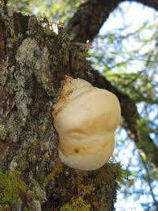

Slide 3
Common name :
Larch Agaric; white agaric; polyporus officinale
A fungus growing on the larch tree (Larch trees are large deciduous trees with short needles and cones) ; formerly called Boletus laricis.
Prover: Burt
Active principle is Agaric Acid or Agaricin
Tincture is prepared from the dried fungus

Slide 4
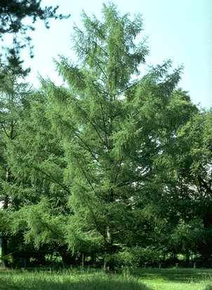
Larch tree

Slide 5
CLINICAL USES:
Diarrhoea; Dysentery; Fever; Gall-bladder, affections of; Headache; Liver, diseases of.

Slide 6
MIND:
- Very gloomy and despondent. - Irritated at the least trifle. - Absent-minded.

Slide 7
HEAD:
- Head feeling very light and hollow, with deep frontal headache and great faintness.

Slide 8
EYES:
Agglutination of eyelids morning, with dull, aching pains in eyeballs.

Slide 9
MOUTH: - Teeth and gums very sore. - Tongue: white coat, thick yellow coat showing marks of teeth. - Taste: flat, coppery, unnatural, of all food, lost.

Slide 10
STOMACH:
- Feeling in fauces as if would vomit. - Nausea and vomiting. - Great faintness at epigastrium.

Slide 11
ABDOMEN: - Severe cutting pains in stomach every few minutes, with dull, aching distress in umbilicus, and loud rumbling in bowels all night.
- Heavy dragging pains in liver, more in right lobe.
- Dull, burning distress, drawing, aching in right lobe of liver with frontal headache and whole dorsal region on full inspiration.

Slide 12
- Sharp cutting pains near gall-bladder. - Burning distress in region of gall-bladder all afternoon - Severe, dull, aching distress just below stomach, causing great faintness.

Slide 13
STOOL:
- Straining after stool. - Stool: Thin, yellow papescent, mixed with something looking like oil in large and small drops, followed by aching in liver and umbilicus. - Black, lumpy, dry stools mixed with bile and mucus. - Stools of bile, mucus, and blood, with high fever.

Slide 14
BACK:
- Dull, aching distress in back and legs.
GENERALITIES
- Great restlessness after midnight. - Faintness after stool. - Aching distress in all joints.

Slide 15
FEVER:
- Chilliness along spine with frequent hot flashes of fever. - Disposition to yawn and stretch when chilly. - Face hot and flushed with severe frontal headache. - Hands hot and dry. - Waking at midnight two different nights in a profuse perspiration.

Slide 16
- Severe aching in shoulders and joints and small of back.
- Profuse perspiration at night, with hectic chills and fever.
SKIN:
- Hot and dry, especially in palms.
- Itching more between scapula and on forearms.

Slide 17
RELATIONSHIP:
Compare:
- Agaricin, active constituent of Polyporus
- Boletus luridus (Violent pain in epigastrium, urticaria tuberosa).
- Boletus satanus (dysentery, vomiting, great debility, cold extremities, spasm of extremities and face).

Slide 18
THANK YOU…….

